Slide 1
Stark County
Land Bank Session
2026 Governmental Law Seminar
Sarah Peters – John Anthony
Notes:
ID=d924773e-9a16-4d6d-9803-8cb819e99682
Recipe=text_billboard
Type=TextOnly
Variant=0
FamilyID=AccentBoxWalbaum_Zero

Slide 2
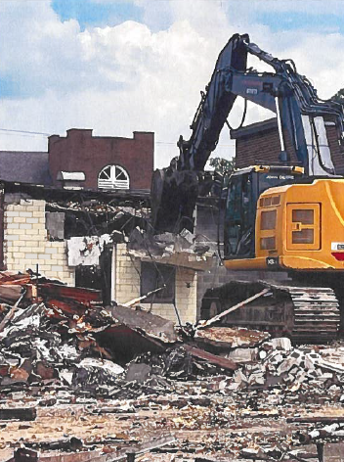
Session Overview
Session Introduction
What is a Land Reutilization Corporation
Stark County Land Bank – Background & History
Current Programs & Grants
Recent Litigation & Land Bank Operations
Pending Legislation
Questions

Slide 3
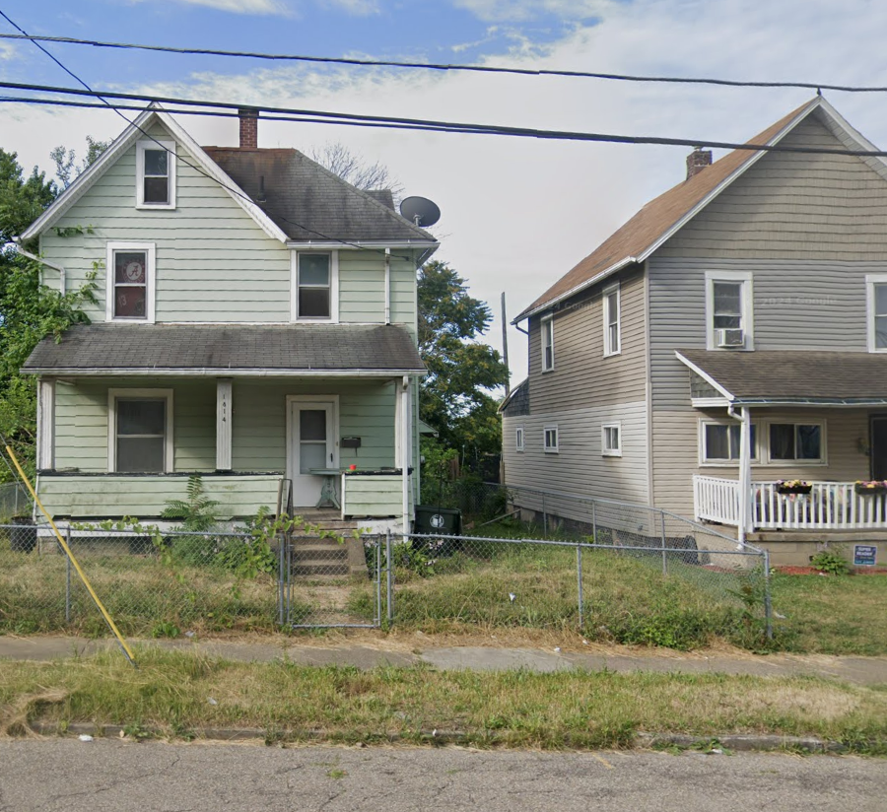
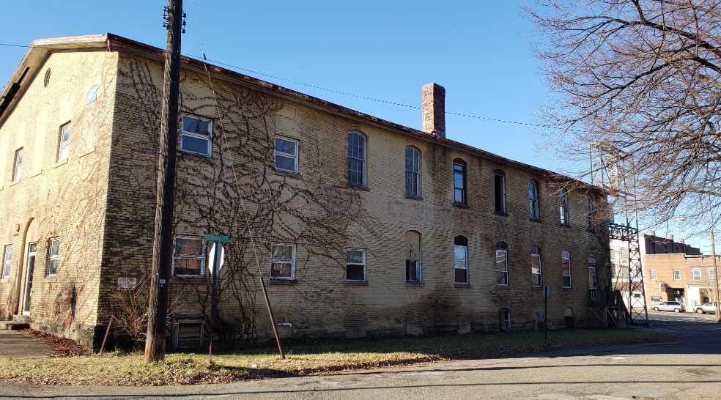
Introduction
During this session we hope to provide you with information regarding the Stark County Land Reutilization Corporation (Land Bank), available programs may be beneficial to your organization or community and will update you on recent and pending legislation that effects the work that Land Banks do.

Slide 4

What is a Land Bank?
LRC – land reutilization corporation
aka “land bank”

Slide 5
WHAT IS A LAND BANK?
“County Land Bank” is the informal name for a land reutilization corporation. County land banks facilitate the return of vacant, abandoned, and tax-foreclosed properties to productive economic use. County land banks can take ownership of properties and clear title, assemble parcels for development, and manage properties until redevelopment can begin.
The Cuyahoga Land Bank was the first county land bank created in Ohio after the passage of State enabling legislation, (S.B. 353, 127th General Assembly).

Slide 6
WHAT IS A LAND BANK?
ORC 5722.02 & ORC 1724.04
County Land Banks serve as a resource for communities by helping to stabilize the property tax base, and to reduce and eliminate blight.
  Acquire properties with uncollected/delinquent taxes & to extinguish those taxes
  Clear the title of subordinate liens
  Transfer title free and clear to new ownership

Slide 7
Stark County
Land Bank
2012 - present

Slide 8
“TO STRATEGICALLY ACQUIRE PROPERTIES, RETURN THEM TO PRODUCTIVE USE, REDUCE BLIGHT, INCREASE PROPERTY VALUES, SUPPORT COMMUNITY GOALS, AND IMPROVE THE QUALITY OF LIFE FOR COUNTY RESIDENTS”
Mission

Slide 9
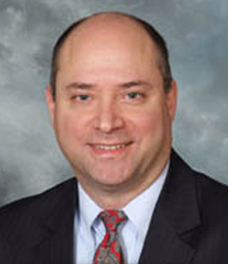
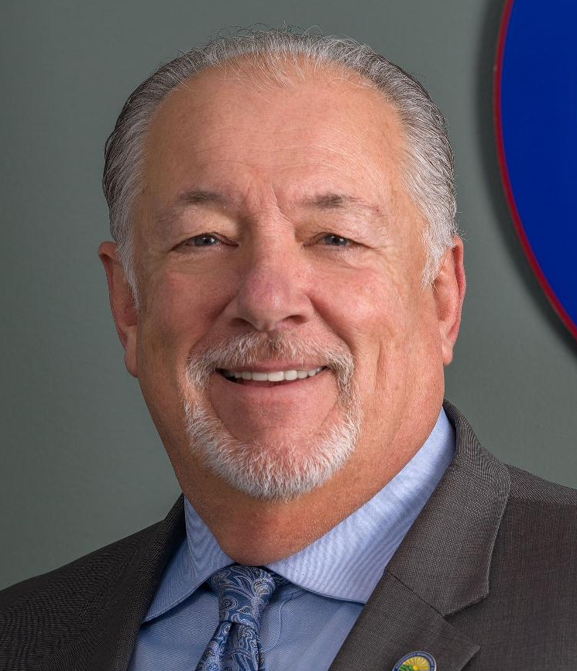
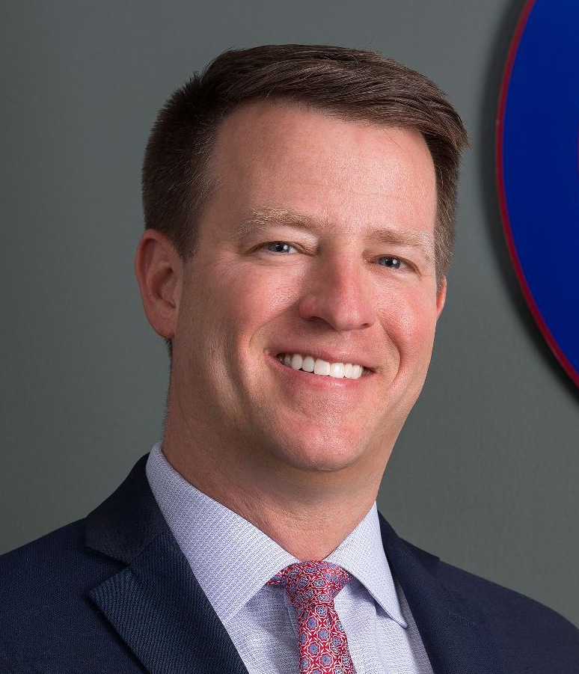

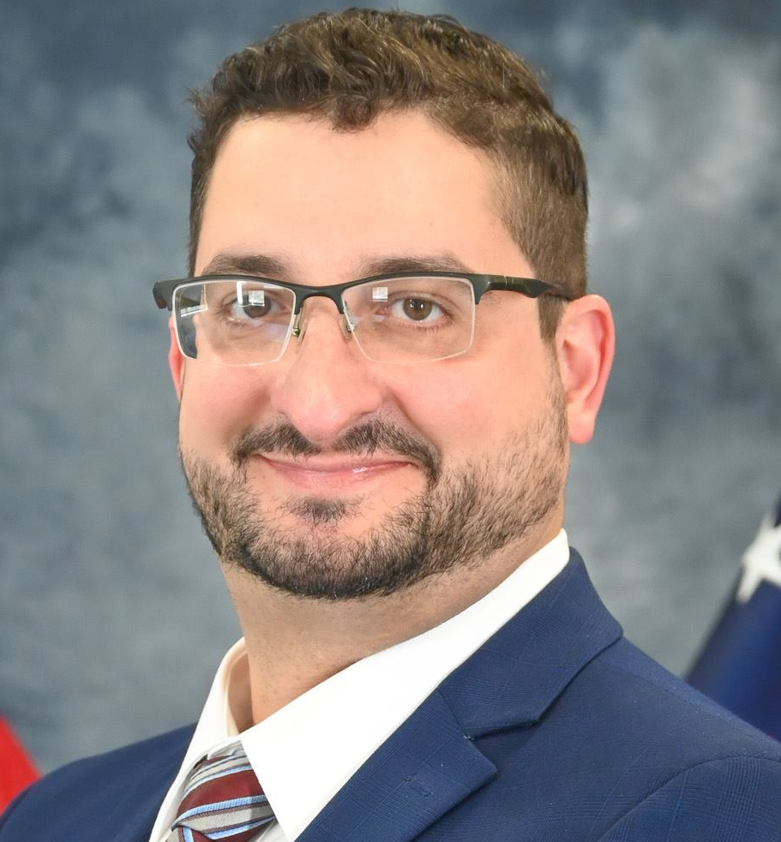
BOARD OF DIRECTORS
Alex Zumbar
Chairman
Bill Smith
Vice Chair
Alan Harold
John Arnold
Peter Zahirsky

Slide 10
NOTABLE ACCOMPLISHMENTS
Demolished over 1,200 blighted, abandoned residential structures
Transferred over 2,000 properties to new ownership
Received over $5 million in state grant funding to undertake demolition and brownfield remediation activities
Received $2 million in state grant funding for the purchase of 10 new construction single-family homes in Canton

Slide 11

Current Programs

Slide 12
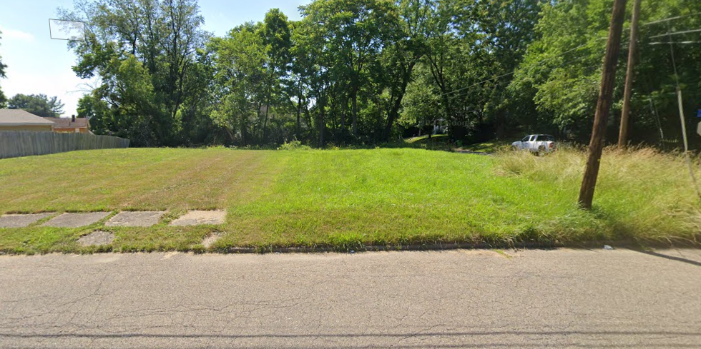
Side Lot & Vacant Lot Programs
The Land Bank is able to acquire and clear the title to these tax delinquent, vacant and abandoned properties in order to transfer them into the hands of new ownership and bring them back into a tax producing status.
New Program Pricing (effective 1/1/2025)
Side Lot – Owner Occupant $100/lot
Side Lot – Investment $500/lot
Vacant Lot Assessed Value + $1,500
Lots Qualifications
Certified tax delinquent (1-year minimum)
Vacant, unimproved property
15,000 sq.ft. or less in size (Side Lot only)

Slide 13
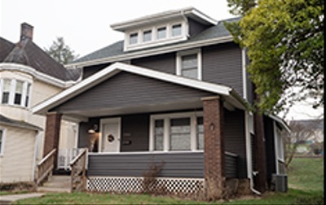
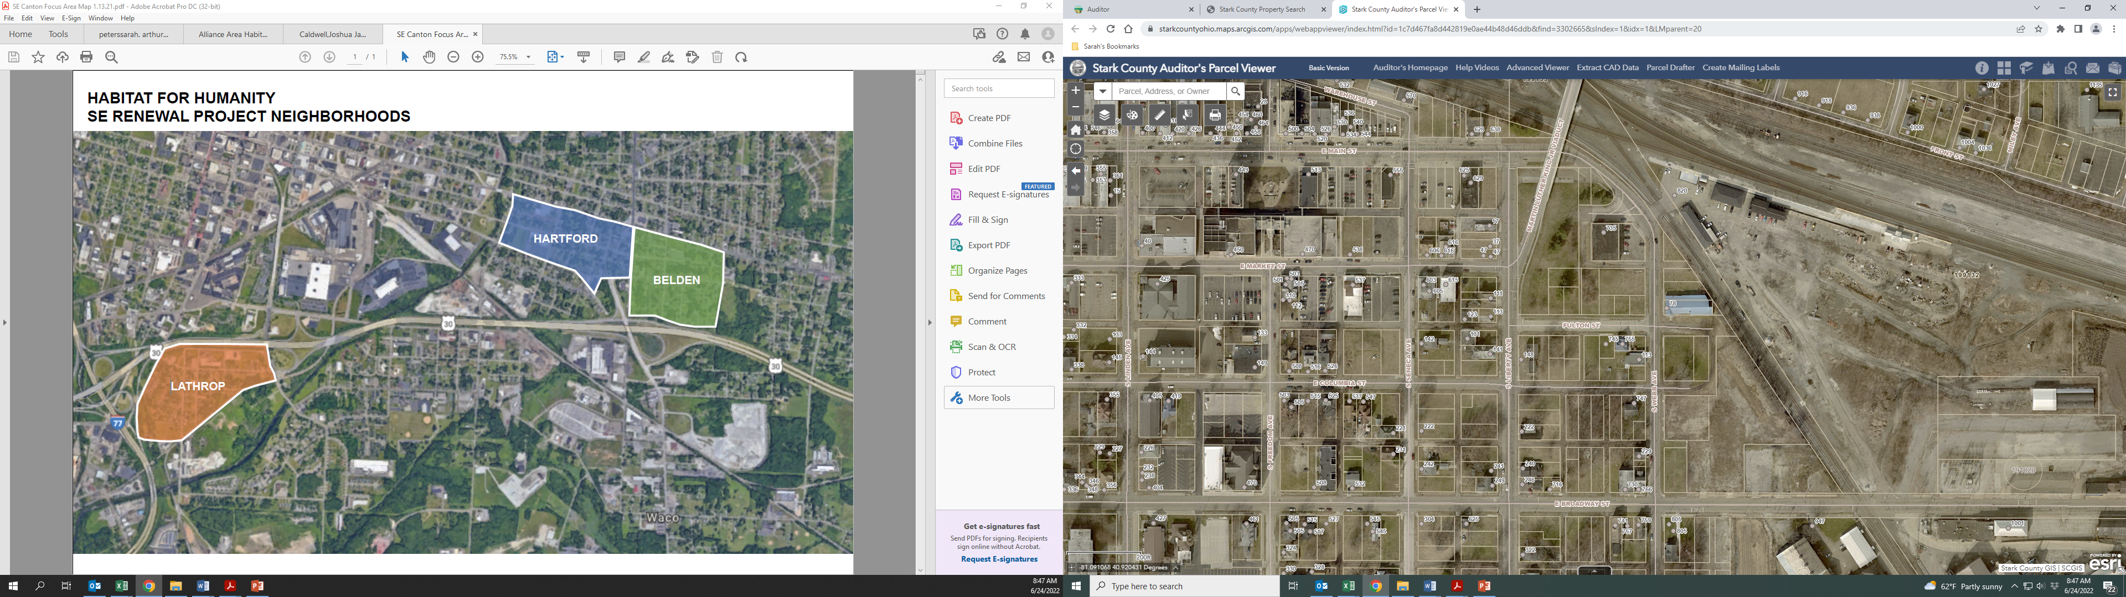
Targeted Acquisition Assistance Program
The Land Bank offers a strategic acquisition program available to Stark County political subdivisions and non-profit organizations.
Entities utilize this program for various purposes:
            Rehab/Redevelopment
            New Construction
            Demolition
            Land Assembly

Slide 14
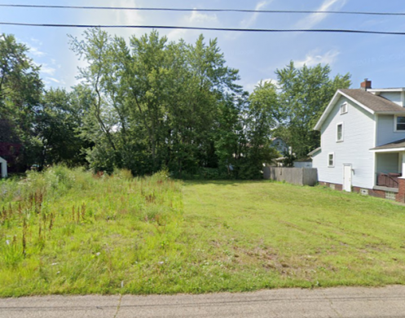

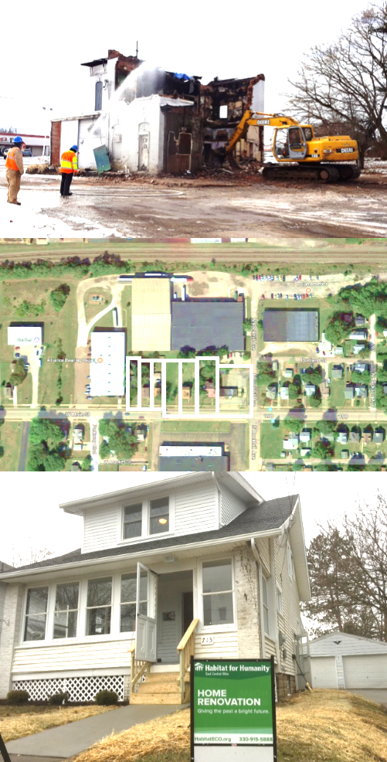
Targeted Acquisition Assistance Program
Past Projects
Home Renovation
Habitat for Humanity applied for assistance in acquiring a vacant house
Land Bank was able to foreclose, acquire and transfer title to Habitat for Humanity, who renovated the home and sold the property to an LMI homeowner
Land Assembly
Between 2022 – 2025 the City of Canton applied for assistance in acquiring vacant lots throughout the Greater Shorb/Newton Area and within an area along the Nimishillen Creek targeted for flood plain restoration and water quality improvement
Nearly 300 parcels were transferred between these targeted areas

Slide 15
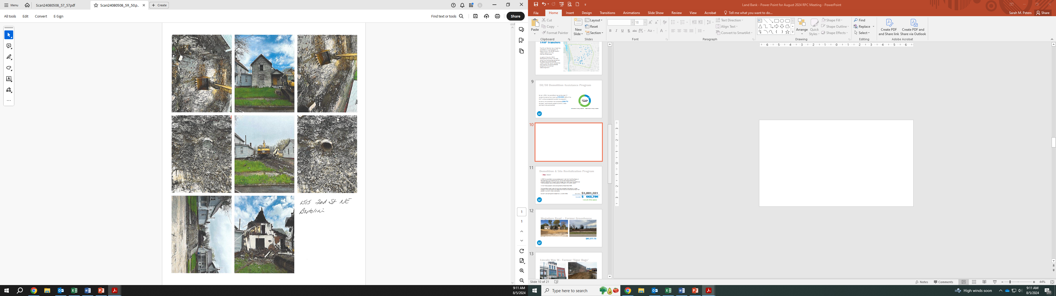



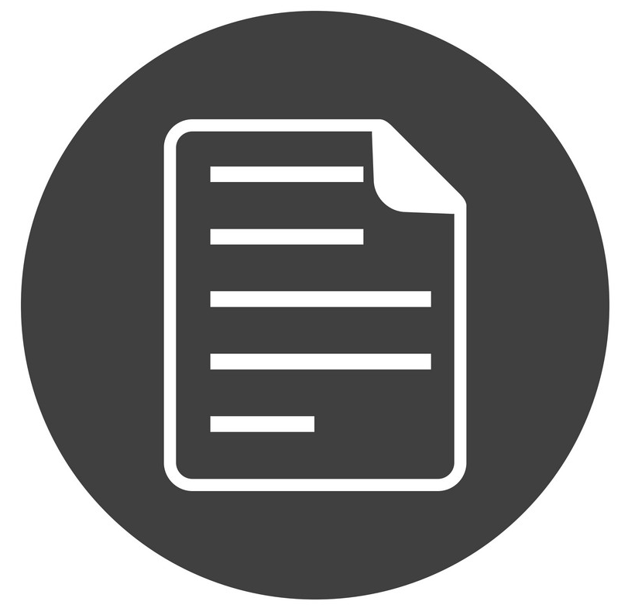

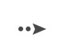
50/50 Demolition Assistance
Applicant Identifies a Property for Demolition
& Submits a DAP Application
Application is Reviewed by RPC and Approved for Funding by Land Bank
Applicant Completes all necessary Demolition work
Applicant Requests Reimbursement
RPC Reviews documentation &
Land Bank Issues Reimbursement

Slide 16
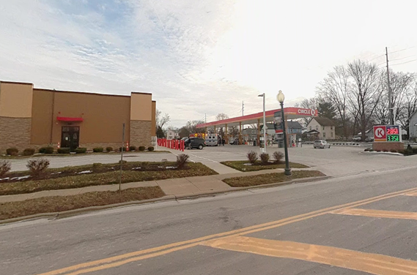

50/50 Demolition Assistance
Past Funded Project
633 N Union Ave., Alliance
$50,0000 DAP Reimbursement
received in March 2020
New Development
Circle K Gas Station

Slide 17
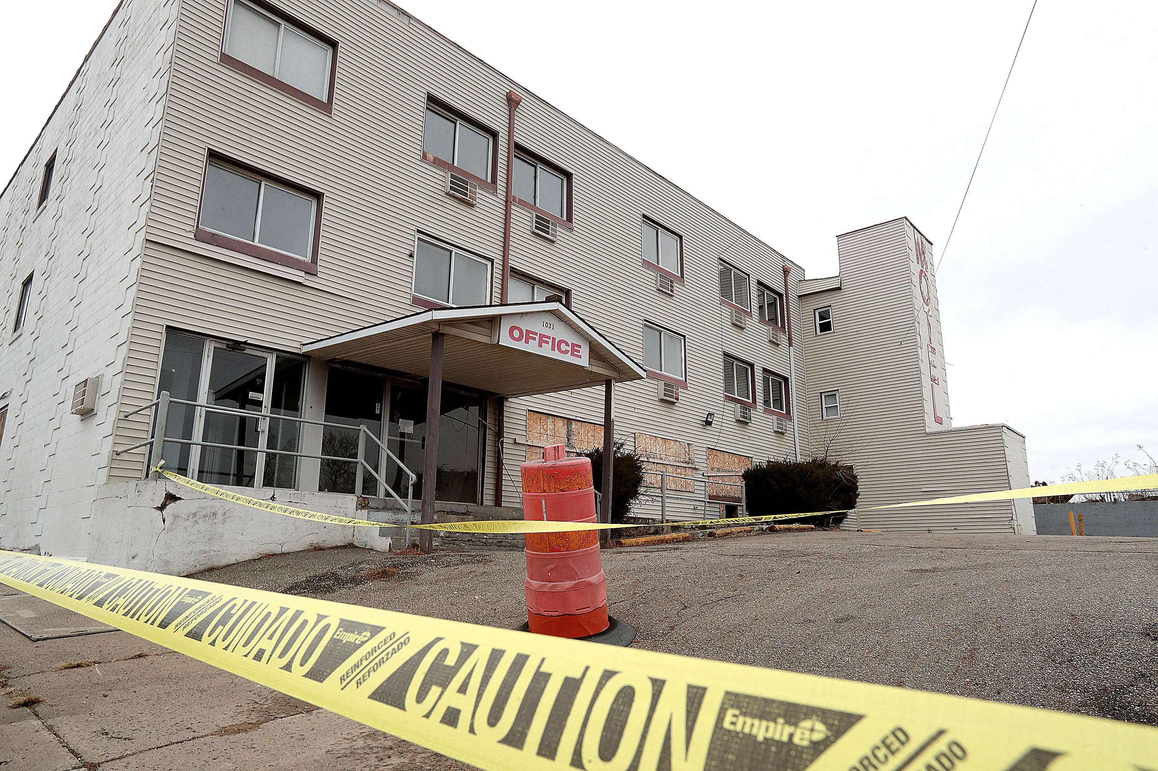
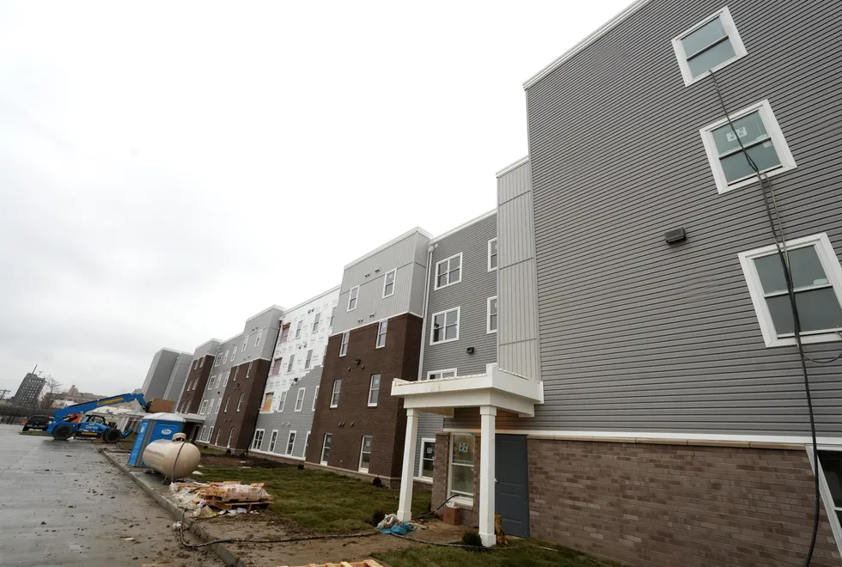
50/50 Demolition Assistance
Past Funded Project
W. Tuscarawas St., Canton
$70,588 DAP Reimbursement
received in December 2022
New Development
Newton Family Apartments
Canton for All People Inc.

Slide 18
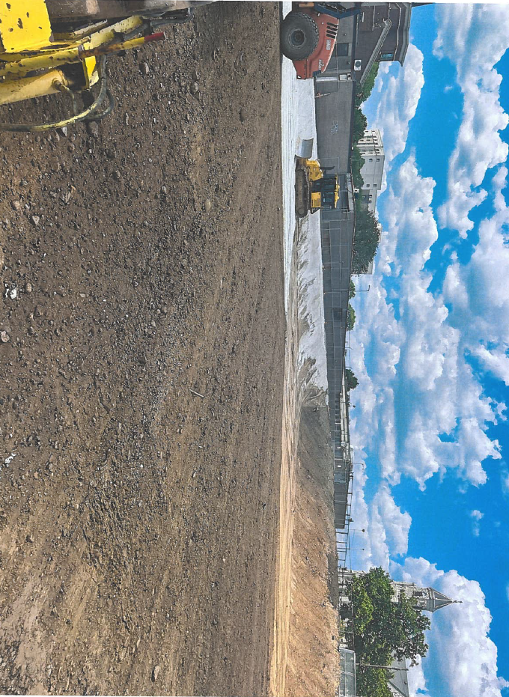
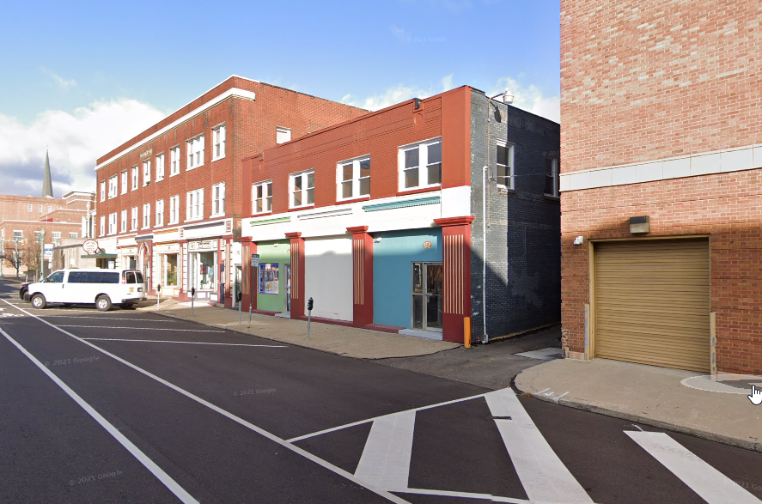
50/50 Demolition Assistance
Past Funded Project
6th St. NW, Canton
$216,392 DAP Reimbursement
received in September 2024
Renovation
Canton Palace Theatre

Slide 19
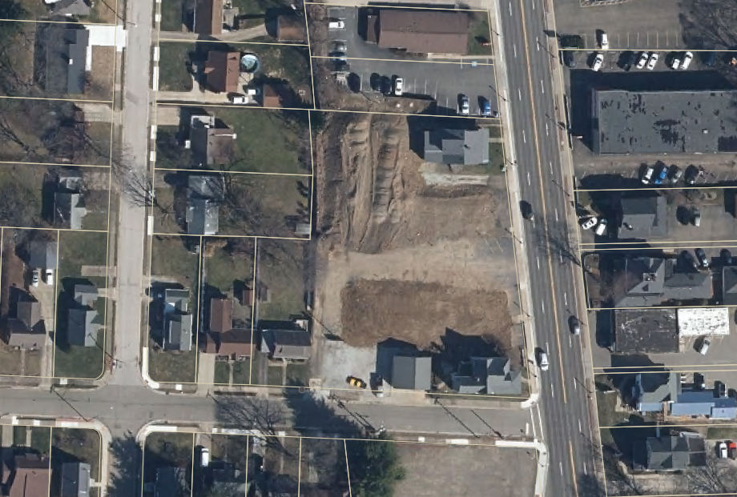
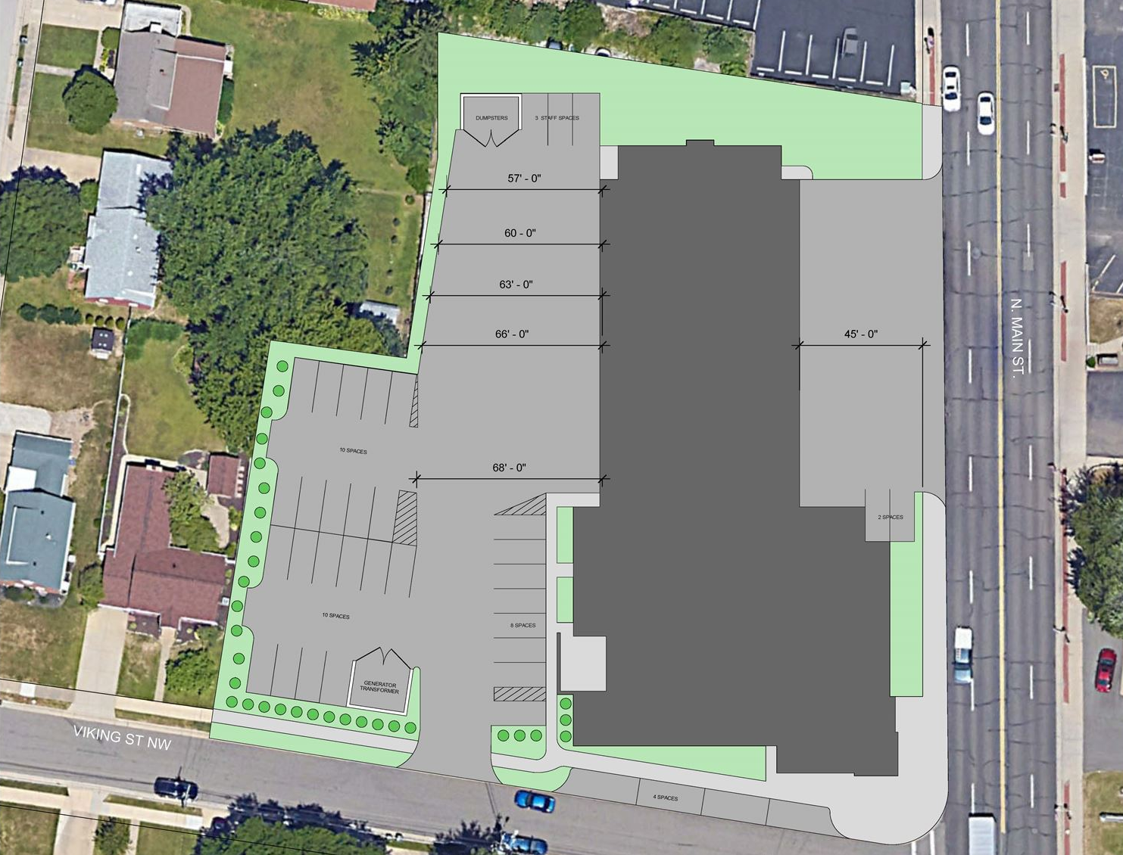
50/50 Demolition Assistance
Past Funded Project
Image of Site Plan taken from https://northcantonohio.gov/FireProposal
N. Main Street., North Canton
$20,175 DAP Reimbursement
received in June 2025
Planned New Development
Fire/EMS Station

Slide 20

State grant funding
AWARD YEAR | PROGRAM | FUNDING AWARD | TOTAL SPENT | DESCRIPTION
FY 2022 | Demolition & Site Revitalization | $1,001,321 | $953,288 | Demolition of 7 commercial structures
FY 2024 | Demolition & Site Revitalization | $500,000 | $366,882 | Demolition of 29 structures
FY 2024 | Welcome Home Ohio | $2,000,000 | $600,000 | Purchase & Sale of 10 New Construction Homes
FY 2024 | Brownfield Remediation | $3,626,358 | $580,817 | 3 Remediation Projects
FY 2026 | Demolition & Site Revitalization | $230,000 pending | -- | Multiple Demolition Projects
FY 2026 | Brownfield Remediation | $300,000 pending | -- | 1 Assessment Project

Slide 21
Litigation & Land Bank Operations

Slide 22
Litigation & Land bank operations
TYLER v. HENNEPIN COUNTY
Limits recovery to what is owed in taxes and no more
Need for a sale to provide the party owed potential surplus funds derived from the sale
Failure to do so violates the taking clause of the 5th amendment of the U.S. Constitution

Slide 23
Litigation & Land bank operations
TYLER v. HENNEPIN COUNTY
598 U.S. 631 (2023)
Seems to resolve the issue of the legality of direct transfers to an eligible entity under Ohio law in an expedited tax foreclosure case without a sale and compensation to the owner.
Though the Ohio process already had some protection the legislature is in the process of making revisions to O.R.C. 323.78 to make it clear that owners and other interested parties can request a public auction sale to unlock potential surplus value
Bottom line is that you have to create a way to recover surplus value for the owner or other interested party.

Slide 24
Expedited Foreclosure process for tax delinquent abandoned property in Stark County
ORC 323.66 – 323.79
Conventional foreclosure through the Courts requires a Sheriff Sale and two attempts. If no bid no sale after two attempts the property will likely be forfeited to the State and sold at a later date by the County Auditor.
Upon request the Land Bank can acquire property forfeited from the Auditor’s list free and clear liens O.R.C. 5723.04(B)
The Board of Revision has jurisdiction over expedited foreclosure under Ohio Law and in many cases can order a transfer of abandoned property directly to the Land Bank and avoid a sale.
Direct transfers to the Land Bank may occur if taxes due exceed the value of the property and if the 28 day alternate redemption period invoked by the Treasurer expires.

Slide 25
Litigation & challenges to expedited foreclosures
by the Board of revision & direct transfers
to land banks
Feltner v. Cuyahoga County Board of Revision
160 Ohio St. 3d 359 (2020)
State ex rel. US Bank Trust, Natl. Assn. v. Cuyahoga Cty.
172 Ohio St. 3d 295 (April 4, 2023)
Tyler v. Hennepin County
598 U.S 631 (May 25th 2023)

Slide 26
The effects of Tyler v. Hennepin county
& Ohio Land Bank operations
Ohio Land Banks rely on expedited foreclosure processes to acquire properties for programs that are consistent with the Land Bank’s mission, such as Side Lot and TAAP, and in general for the reutilization of non-productive abandoned property
A sheriff sale causes delays, adds to expense, and interferes with planning in cases that result in a sale to a third party

Slide 27
Board of revision orders in light of the Hennepin decision
If the taxes and impositions (costs) owed exceed the value of the property as shown by the county auditor’s valuation, then it is likely that a direct order of transfer can be made without a potential consequence of a valid equity claim.
If the valuation is greater than the taxes owed and therefore potential equity exists, then a direct transfer may not be proper under the Hennepin decision. (There may be a possibility of waiver under Ohio Law).
Many if not most Land Banks in Ohio stopped using the BOR and direct transfers even before Hennepin when lawsuits started to appear in the Courts challenging the direct transfers as the unlawful taking of property .

Slide 28
Legislative Changes

Slide 29
Legislative changes in expedited foreclosure procedures
GUS FRANGOS ACT - HB 86/SB 102
Changes are coming in what has been named the Gus Frangos bill:
Protecting owners' equity i.e. allowing for sales upon demand
Improving Ohio’s housing stock
Provide for enhanced Land Bank relationships with government partners
Note: last check it is still in committee. It appears to be a large comprehensive overhaul of the Board of Revision procedure with respect to foreclosure.
A full text as well as a summary of the bill can be found at
Legislature.ohio.gov/legislation/136/sb 102
Ohiosenate.gov/legislation/136/hb102/documents

Slide 30
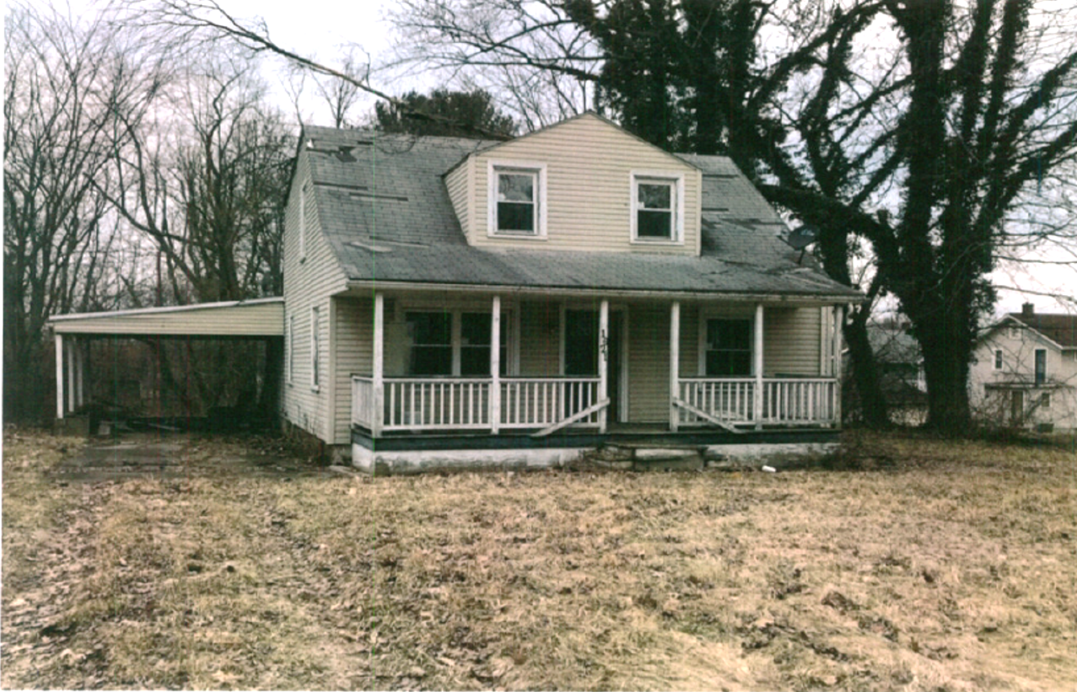
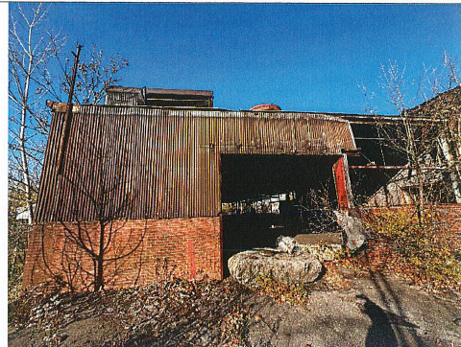

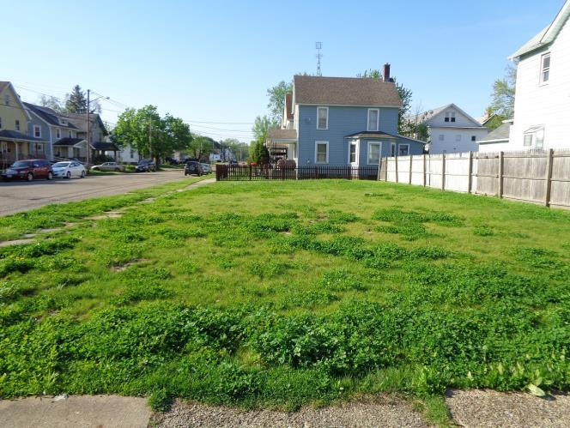
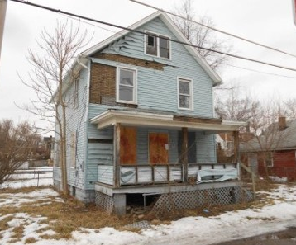

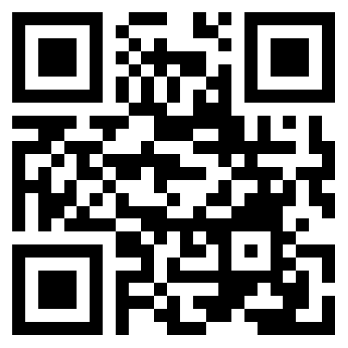
Thank you
Sarah Peters
John Anthony
smpeters@starkcountyohio.gov
jfanthony@starkcountyohio.gov

